Slide 1


Web Assembly + Rust
Are we web yet?

Slide 2

Topics
What is WASM?
Can I Easily make Good Web Apps with WASM that are Performant enough for Prime Time?
How? (spoilers, with Rust)

Slide 3
What is Web Assembly?
A lot of things actually...
Portable binary instruction format
Textual format
Binary format
Compilation target for other programming languages
An Open Standard
Portable Virtual Stack Machine
Bonus: if combined with WASI/WASIX, it can even be a software container

Slide 4
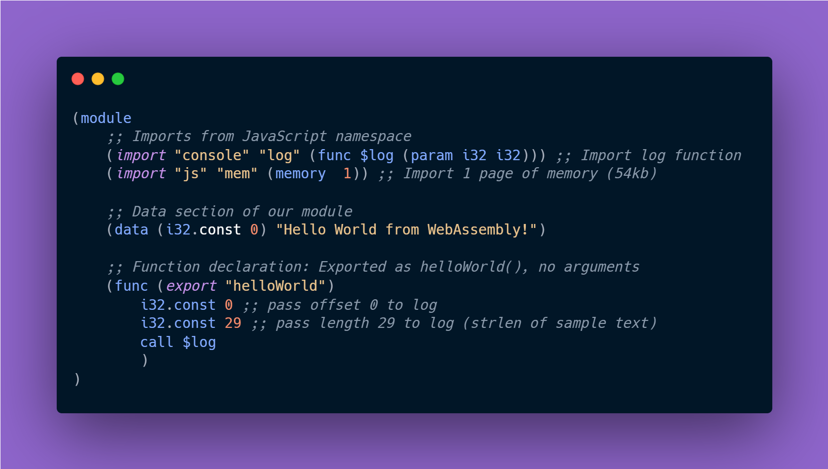
hello_world.wasm

Slide 5
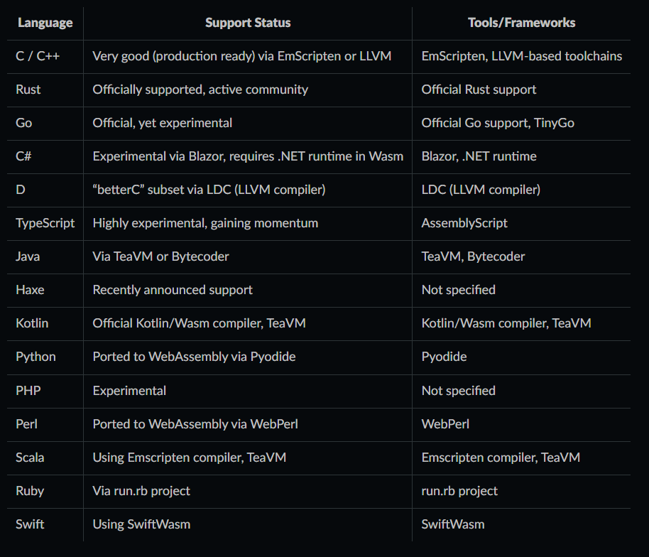
Languages that compile to WASM
Web Assembly is supported as a compile target by various languages.

Slide 6
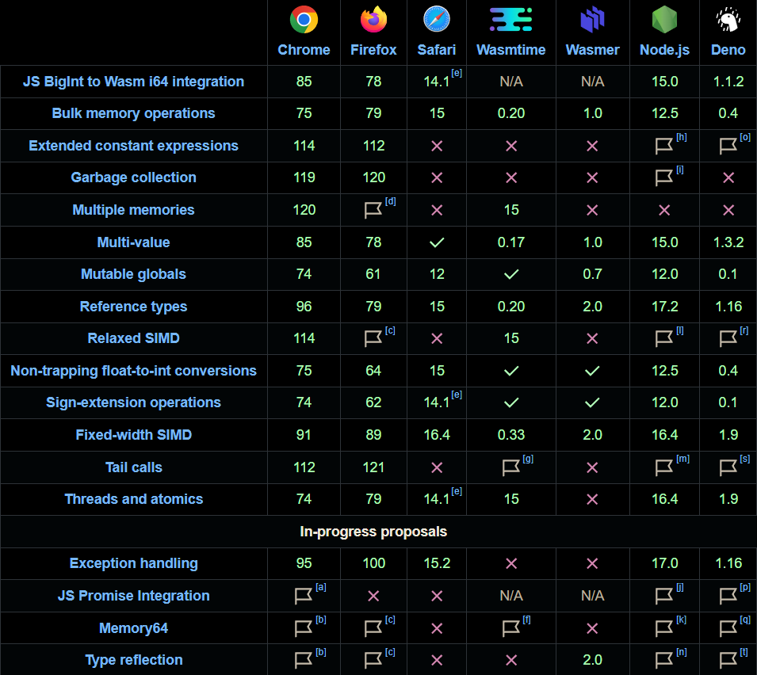
Supported Runtimes / Environments
WASM features and their support state in different runtimes
Web Assembly
is supported both on the Server and on the Browser

Slide 7

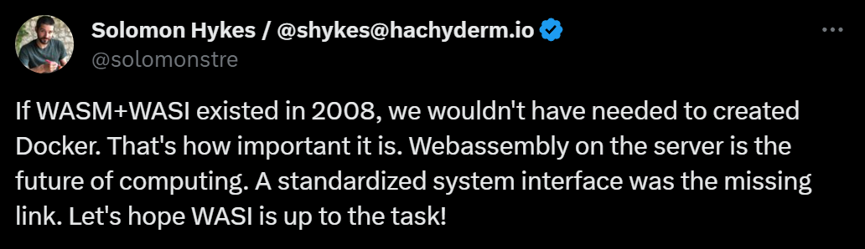
WASM + WASI is portable and self-contained

Slide 8



Why WASM?
Language Agnostic!
Performance!
SECURITY!

Slide 9
No but why though...
Broader Horizons and more possibilities due to the massive efficiency of doing computationally and graphically intensive work with WASM.
Benefitting off of the battle-tested ecosystems of other technologies.
Runtime safety.

Slide 10

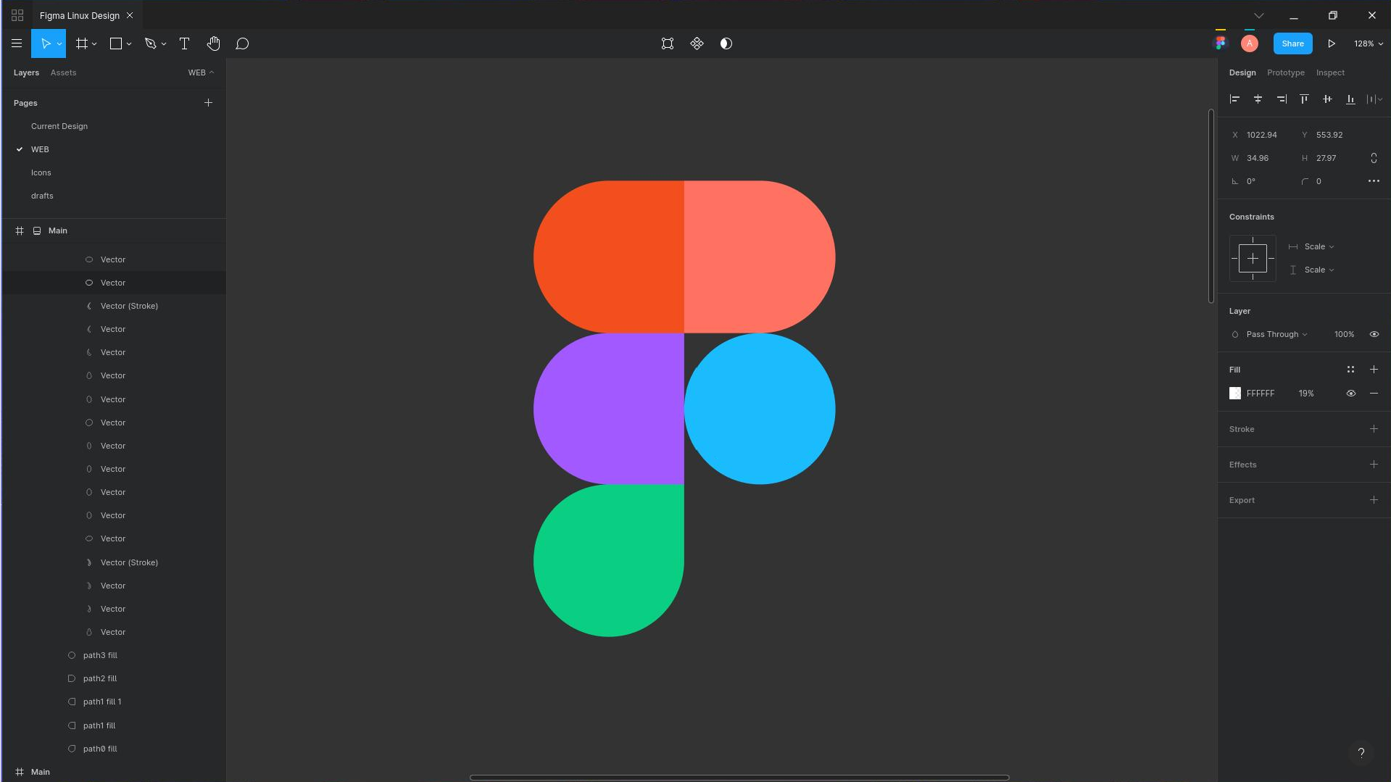
How Broad?
Here are some examples of WASM in the wild.
Figma
Collaborative, Real-Time Design and Prototyping Tool

Slide 11
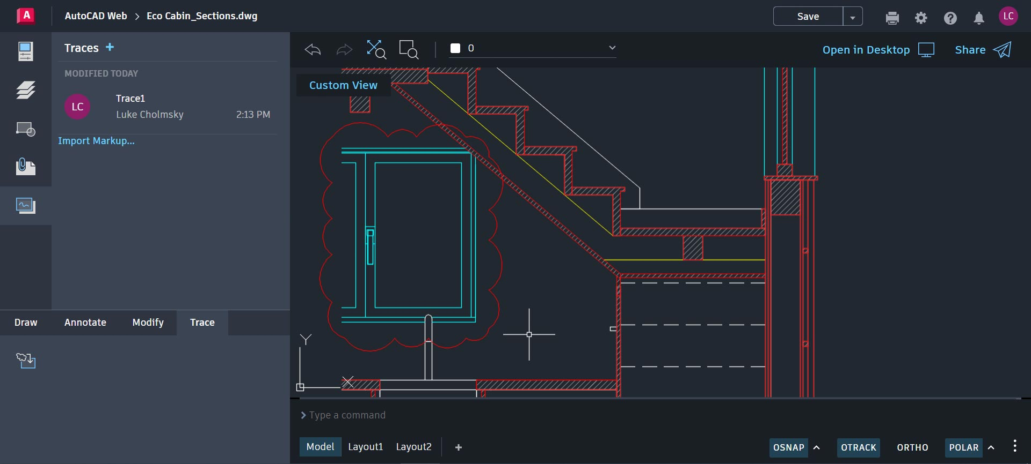
AutoCAD Web
Browser-based version of the renowned industry standard AutoCAD - a platform for designing, drafting, and documenting projects.

Slide 12

DOOM 3 (60fps)
FPS video game known for its advanced graphics engine, featuring impressive real-time dynamic lighting and shadow effects.

Slide 13
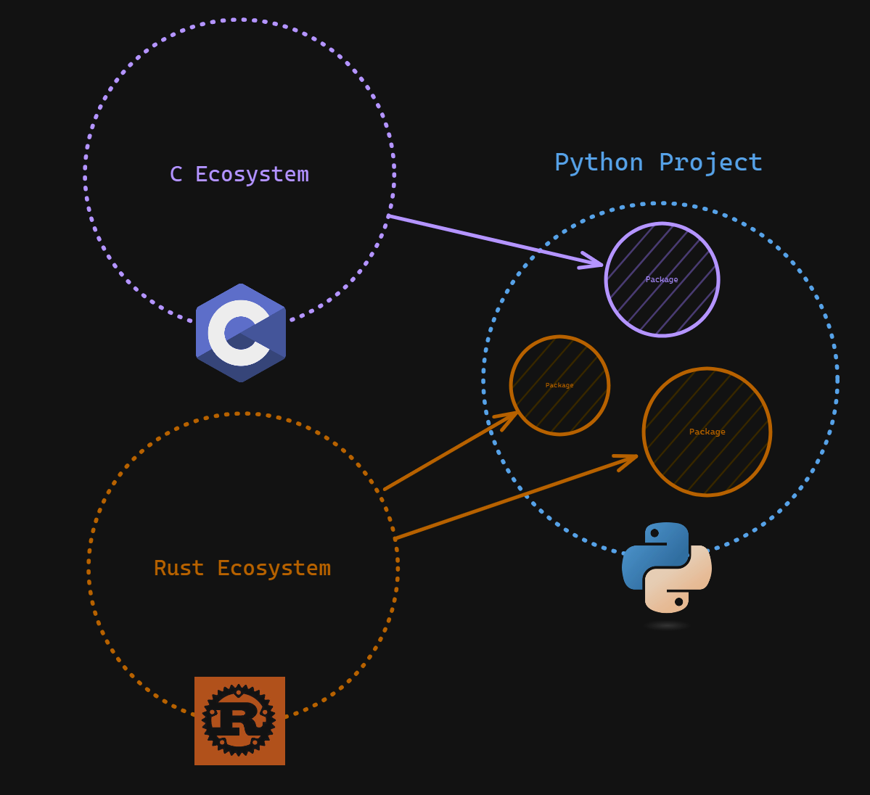
Capitalize on existing Ecosystems
No matter what technology they are written in.

Slide 14
Safety
Languages with extensive type systems can be used to target WASM to ensure type safety.
Languages with more modern safety features can be used to ensure runtime safety at compile-time.
Languages with more control on memory can be used to address memory issues.

Slide 15
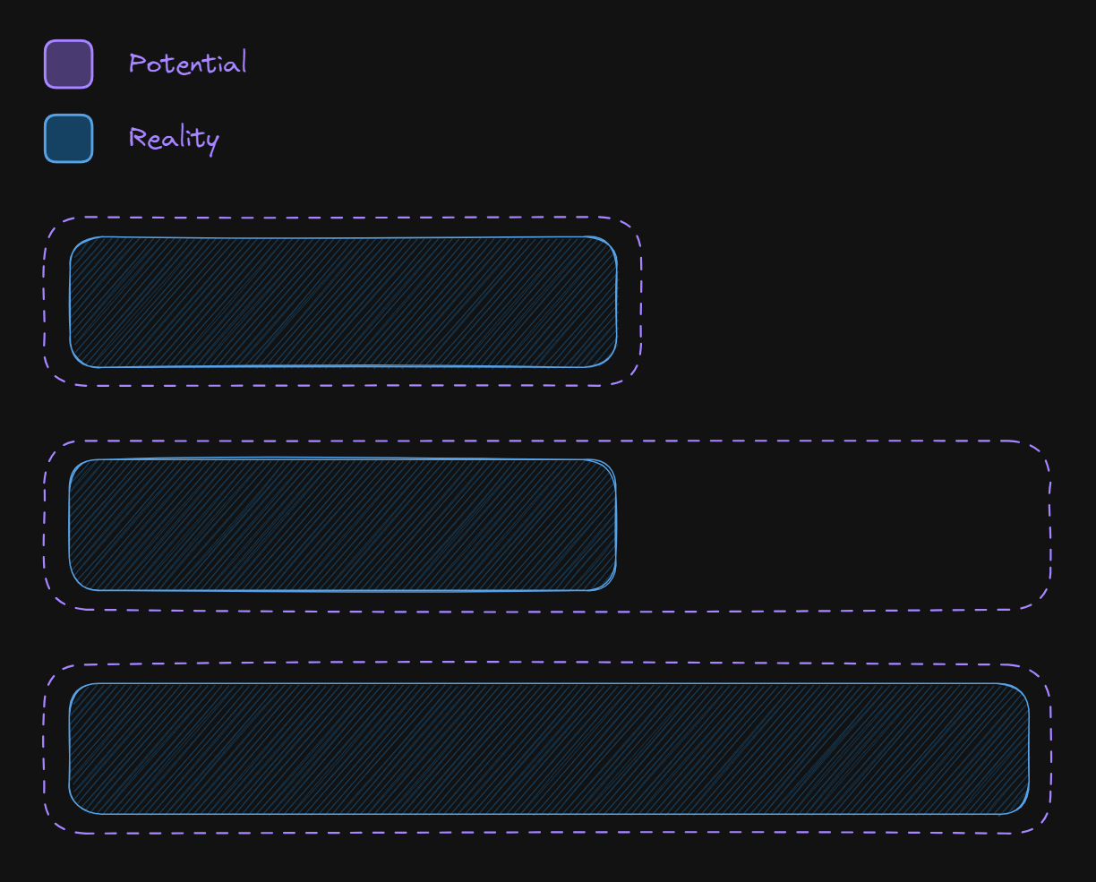
Quick Heads Up!
WASM makes potential. Not Promises.
WASM is not a one-size-fits-all solution.
The right set of tools should be chosen to work with WASM.

Slide 16

Enter Rust.

Slide 17

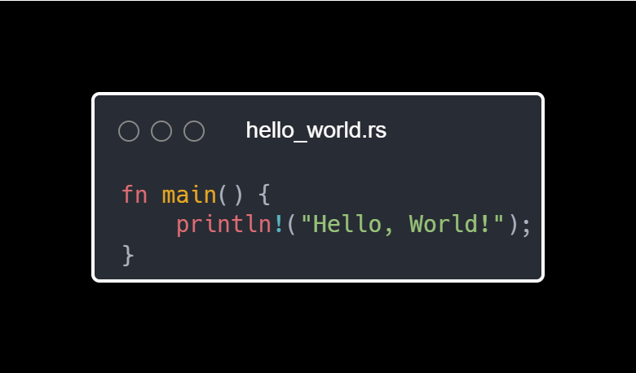
What's that?
Is a low-level systems programming language, with high level features.
It is statically typed and has a rich type system. It has no garbage-collector and ensures runtime safety by enforcing strict compile-time rules following the RAII pattern.

Slide 18
Why use RUST for WASM?
It has no garbage collector.
It gives the developer direct access to memory.
It compiles natively to WASM and WASI.
It has excellent WASM ecosystem support.
It fulfils all the potential WASM provides.
Is an overall awesome language.

Slide 19

Talk is cheap. Show me the code.
-Linus Torvalds

Slide 20
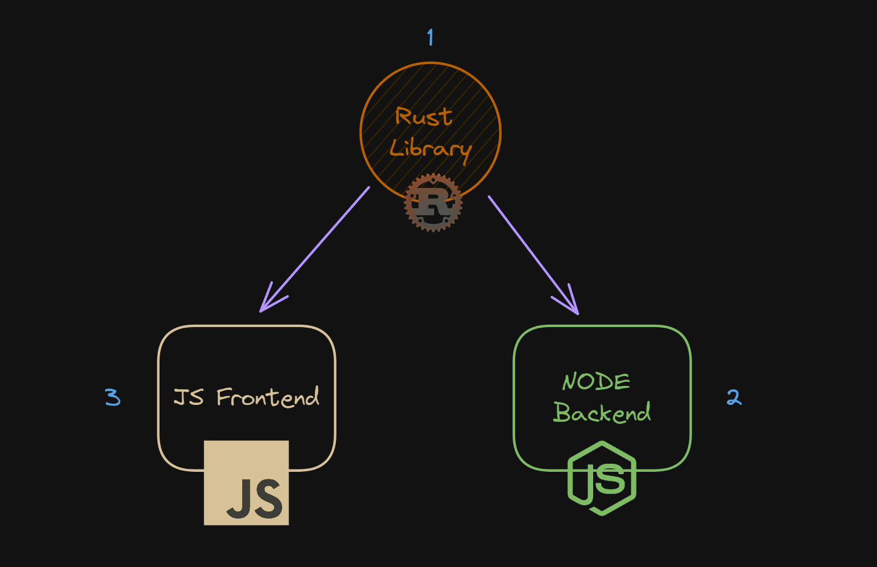
Here's what we'll do:
Make a shared Rust library.
Use the library in a Node.js backend service.
Use the library in a web frontend.

Slide 21

Creating The Rust Library
Initialize Rust project.
Define .wai interface.
Implement interface.
Upload to wasmer.io.
Profit.

Slide 22
Welcome Back!

Slide 23

Your turn!

Slide 24

Consuming the library
Initialize a node project (or clone the repository).
Add the Library as a dependency.
Utilize the Library in the project.
Yummy.

Slide 25
Backend Guide
Make sure Nodejs is installed on your machine.
Clone the repository and navigate to the “backend" module.
Run `npm install` to install all dependencies.
Run `npm start` to make sure everything works.
Install the wasmer cli (https://docs.wasmer.io/install).
Install the library using the command.
Add an additional endpoint to the project that calls a function from the library and returns it.

Slide 26
Frontend Guide
Make sure Nodejs is installed on your machine.
Clone the repository and navigate to the “frontend" module.
Run `npm install` to install all dependencies.
Run `npm run dev` to run the application.
(Importing the library is already taken care of, yay!)
Make a button that calls a function out of the library when clicked and shows the return value in the UI.

Slide 27

Phew!
We did it!

Slide 28
Full Stack
Framework | Description
Blazor | Microsoft's client-side framework for interactive web UIs with .NET. Allows writing web UI using C# instead of JavaScript.
Vugu | Go framework supporting components, akin to Vue.js, for web applications with Go and WebAssembly. Still experimental.
Spin | WebAssembly framework for microservices, web apps, and server-based applications. Supports multiple languages.
Yew | Rust framework for multi-threaded front-end web apps with WebAssembly. Inspired by Elm and ReactJS, supports component-based architecture.
Dioxus | Rust-based UI framework inspired by React. Supports web, desktop, and mobile platforms with high performance.
Leptos | Rust and WebAssembly full-stack framework for fast and reactive UIs. Supports server-side and client-side rendering, simplifies interactions with server services.

Slide 29

Leptos
Supports SSR and SSG.
Implements a signal based reactivity model.
Supports RPC and server functions.
Familiar Developer Experience due to the usage of functional components and a JSX-like macro.
Ever-growing community on Github.
Blazingly Fast!

Slide 30
Getting started with Leptos
Make sure Rust is installed and the nightly channel is targeted.
Run `cargo install --locked cargo-leptos` to install cargo-leptos.
Run `cargo leptos new --git leptos-rs/start` to initialize a new project.
Run `cargo run` to make sure everything works.
Get coding!

Slide 31
WASM, yay or nay?
WASM is a rapidly growing cutting edge-technology, expect breaking changes.
It focuses on efficiency, enjoy the ground breaking performance.
It opens the door to a myriad of new possibilities.
The WASM ecosystem is young but growing, you are expected to contribute.
LBNL:
WASM is more than ready for prime-time.

Slide 32


